Slide 1
Compassion Sunday
CULVER CHURCH
145 Culver Grove,
Stanmore, HA7 2NP
Sunday 15th September, 2019

Slide 2
Why Compassion?
Poverty is a young teenage girl forced to marry because her family can’t support her or a boy sent to work on the rubbish heap, rather than being in a classroom. It produces a hopelessness that is unimaginable.
From the womb to early adulthood, we stand for children, giving those born into the toughest of circumstances the opportunities they deserve as we believe that every child is precious and unique.
Nearly 385 million children are currently living in extreme poverty.
We can all make a difference!

Slide 3
Why Compassion?

Slide 4
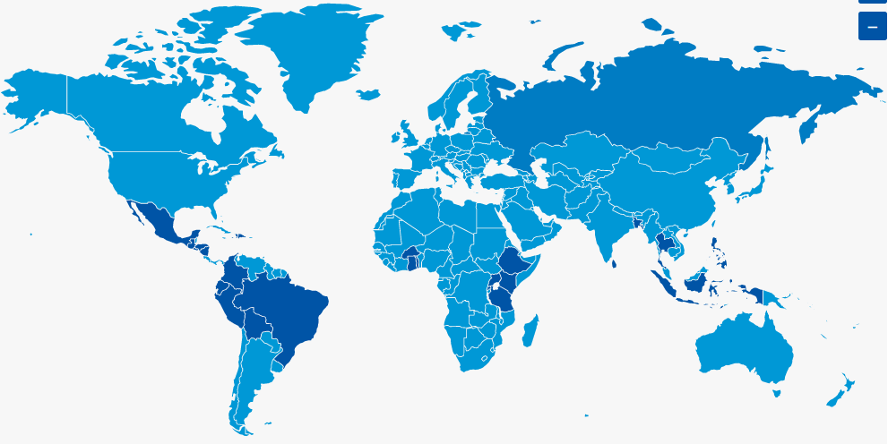
Where we work…..
2 Million Children
25 Countries
7,000 Projects

Slide 5
Stewardship…..
Other support costs
Reserve
Finding new sponsors
Children living in poverty
100% of additional gift go to the child

Slide 6
What the Children get……

Slide 7
The Power of One
Esther – Esther 4: 16
"Go, gather together all the Jews who are in Susa, and fast for me. Do not eat or drink for three days, night or day. I and my attendants will fast as you do. When this is done, I will go to the king, even though it is against the law. And if I perish, I perish."
Jonathan and His Armour bearer - 1 Sam 14; 6
Jonathan said to his young armour-bearer, “Come, let’s go over to the outpost of those uncircumcised men. Perhaps the Lord will act in our behalf. Nothing can hinder the Lord from saving, whether by many or by few.”
5 Loaves and 2 Fish - Matt 6; 38
"How many loaves do you have?" he asked. "Go and see." When they found out, they said, "Five--and two fish.“ Mark 6; 38
The lost sheep – Matt 18; 12
"What do you think? If a man owns a hundred sheep, and one of them wanders away, will he not leave the ninety-nine on the hills and go to look for the one that wandered off?

Slide 8
In Summary………
We can all make a difference if each one reaches one
We can change the world – one life at a time

Slide 9
Pure and undefiled religion before the God and Father is this: to visit orphans and widows in their tribulation; to keep oneself unstained from the world.
James 1; 27

